Slide 1

Media Literacy
or rather
understanding how media, technology, and the internet work
and becoming a free thinker
Dr. Gözel Shakeri
Notes:
Digital media has cooked the way we see and interact with the world.
Today, I want to introduce you to media literacy – or rather, understanding how media technology, and the internet work and becoming a free thinker. I want to share with you how you can deconstruct the ways digital media and the algorithms work, so that you are on your way to owning your own mind again.

Slide 2

Gözel Shakeri
2015-2020: Ph.D. in Human-Computer Interaction
2020-2022: Post-doc in Sustainable Digitalisation
2023: Junior Professor in Sustainable Digitalisation
Since 2024: Consultant in Sustainable Digitalisation
Notes:
About me: I am Gozel Shakeri.
I spent over 10 years in Computer Science, at the frontier of human-computer interaction research.
My passion for media literacy advocacy stems from my expertise. Because I understand, I deeply care about empowering you all to navigate the digital world with clarity and confidence—and I’m thrilled to share this presentation, my first of its kind, with you today!

Slide 3

Today’s goals
Social media algorithms: how they work, how they make money, and how they impact individuals
Behavioural manipulation and the importance of media literacy
Strategies to become a free thinker and curate a healthier media diet
Notes:
This talk has three parts: 1), I will explain how social media algorithms work and how they make money. In part 2) I will explain how the algorithms modify behaviour and hopefully convey the importance of media literacy. In the 3) part, I will give you actionable tools, tips, and strategies on how to become an independent thinker again.

Slide 4
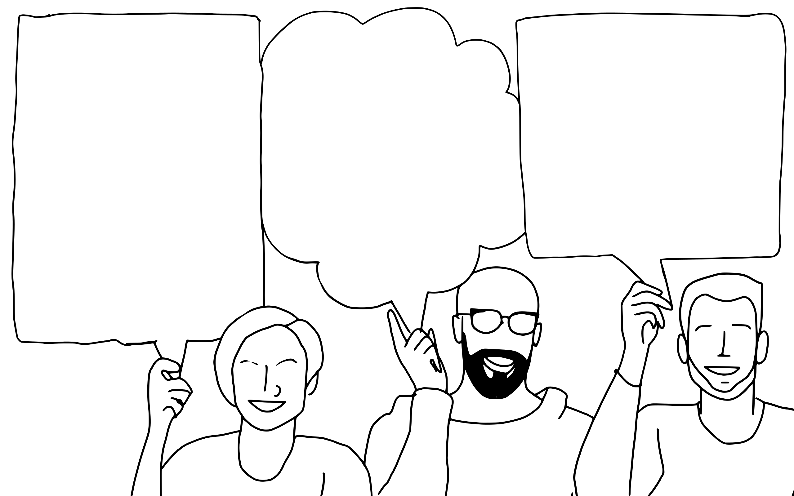
Question 1
Have you found yourself a little bit angrier, more confused, or more lost than usual as of late?
Notes:
By a raise of hands…
Have you found yourself a little bit angrier, more confused, and more lost than usual as of late?
(Yes, thanks to rage bait and internet drama … )
Keep your hands up.

Slide 5
Question 2
Have you “lost” friends and family members to polarisation, radicalisation, and fake news?
Question 1
Have you found yourself a little bit angrier, more confused, or more lost than usual as of late?
Notes:
Have you “lost” friends and family members to fake news?
(Yes, three and counting … )
Keep your hands up.

Slide 6
Question 2
Have you “lost” friends and family members to polarisation, radicalisation, and fake news?
Question 3
Do you need influencers to tell you what to think?
Question 1
Have you found yourself a little bit angrier, more confused, or more lost than usual as of late?
Notes:
Do you need influencers to tell you what to think?
(Yes, it seems I lost my ability to think independently. I don’t know what to think unless an influencer tells me. Also, I don’t have any hobbies left. All I do is YouTube. )
That’s a number! Thanks everybody.

Slide 7
(1)
Social media algorithms:
how they work, how they make money, and how they impact individuals
on the example of YouTube
Notes:
Let me attempt to explain. It may be connected to social media!
But before we get into the workings of the algorithms …

Slide 8

Meet: Bernadette
Lives in Strasbourg
In her 30s
Hates Wednesdays
Loves
cooking,
trekking,
interior décor,
gaming
Notes:
Let me introduce you to Bernadette. Bernadette lives in Strasbourg and she’s in her 30. Bernadette hates Wednesdays because her Wednesdays are packed with meetings, from start to finish. That’s why on Wednesdays, Berndette likes to watch videos on her hobbies; videos on cooking, gaming, interior décor, and trekking.
Think of Berndatte as your guide through the world of algorithms—she’ll help us understand how they work, how they make money, and how they impact our daily lives.

Slide 9
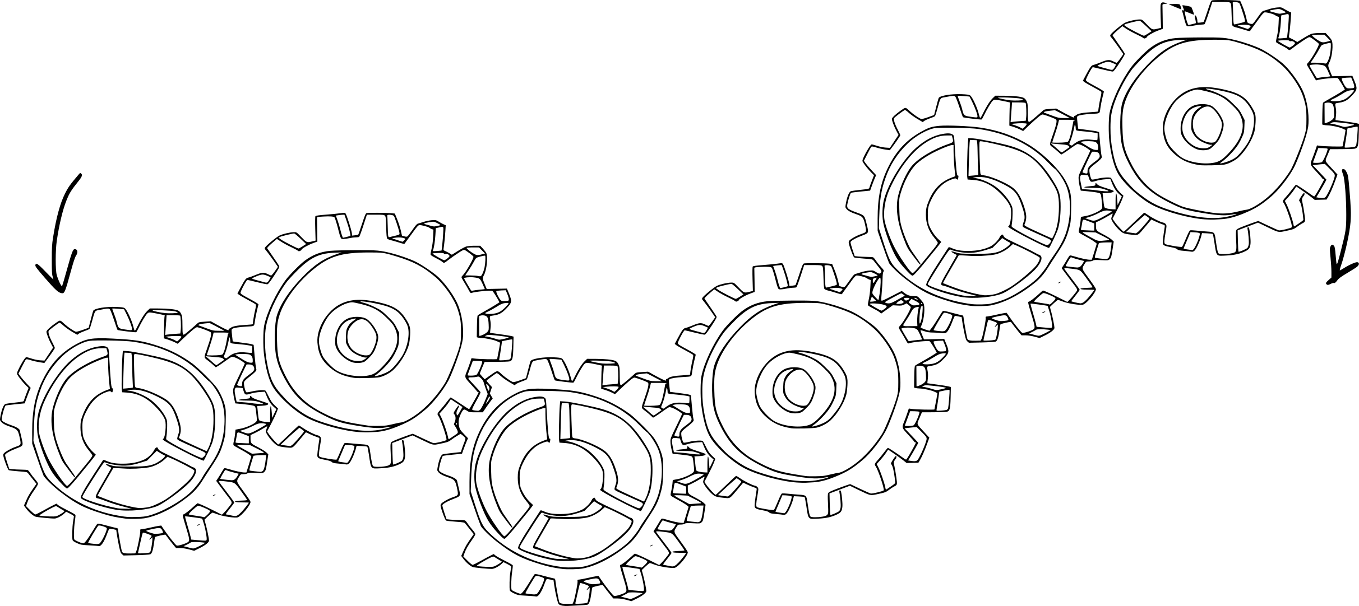


YouTube’s Recommendation Algorithm
user data
user data
Notes:
As our social media algorithm, I chose YouTube for today’s exploration. Via raise of hand, who has used YouTube at least once in their lives?
The reason I chose YT is because - even if you are not on any social media, you are very likely to have encountered Youtube. As the data shows.
YouTube’s algorithm is a complex system designed to decide which videos to recommend to Bernadette.
YouTube’s algorithm is proprietary, so we don’t know EXACTLY how it works, but researchers have reconstructed it.
Based on the vast academic literature out there, Youtube’s algorithm seems to have four major components.

Slide 10
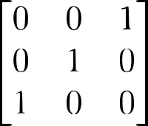
1) Data Extraction: Turning Our Behaviour into Data
Notes:
Component 1: YouTube collects vast amounts of Bernadette’s behavioral data, including:
What she watches: Videos, genres, creators, and topics.
How she watches: Time spent, pauses, rewinds, and skips.
How she interacts: Likes, dislikes, comments, shares, and subscriptions.
What she searches: Keywords and phrases.
Demographics: Location, languages, and more.
For Bernadette, YouTube knows her basic stats—where she lives, what she watches, and that she binge-watches on Wednesdays.

Slide 11
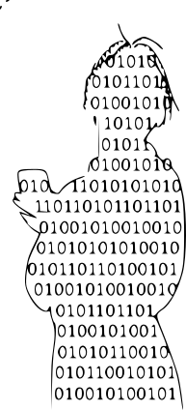
2) Data Analysis: Identifying Our Patterns
Notes:
Component 2: The algorithm analyzes Bernadette’s raw data to create her “digital twin”, inferring her personality traits (e.g., age, income, education) and even her emotions and mental state. For example, if she binge-watches comedy every Wednesday, YouTube might deduce she’s stressed or unhappy at work.

Slide 12

3) Recommendation: Predicting Our Future Behaviour
Notes:
Component 3: The algorithm uses Bernadette’s raw data and “digital twin” to recommend videos it thinks she’ll enjoy. For instance:
If she watches a lot of cooking videos, it might suggest a new cuisine. If she’s been searching for camping tips, it could recommend vlogs from popular campers.
But it goes further: knowing Bernadette is in her 30s, and sometimes stressed —especially on Wednesdays—YouTube might increase her exposure to comedy videos leading up to Wednesday to boost her mood.
That’s nice. Exactly what Bernadette wants from YouTube!

Slide 13
4) Maximising Engagement: Shaping Us
Notes:
Component 4: The algorithm is designed to maximize engagement, keeping Bernadette on the platform longer. For example, not every video she watches on Wednesday fully lifts her mood. If it did, she’d feel better and leave the platform. Instead, YouTube recommends videos that almost hit the mark or trigger other emotions—like outrage or curiosity—creating a craving for the next “hit.”
So, YouTube knows Bernadette is stressed and it knows how to boost her mood, but it doesn’t do enough to help her leave. Instead, it keeps her hooked by playing with her emotions, creating a cycle of craving and withdrawal.
That’s not so nice.

Slide 14
YouTube’s Digital Economy
Reminder: the goal of the YouTube algorithm is to keep you watching.
YouTube’s business model: selling our data.
Notes:
And why does YT do this? Because of it’s business model.
While Berndatte’s goal maybe to relax with videos on a Wednesday, the algorithm’s goal is to keep her watching. And while she is watching, it can sell her data and advertise products to her.

Slide 15
YouTube’s Digital Economy
Reminder: the goal of the YouTube algorithm is to keep you watching.
YouTube’s business model: selling our ...
behaviour
Notes:
YouTube sells data across all four components of its algorithm. Bernadette’s “raw” data i.e. her online behaviour (what she watches and how she watches) is used by advertisers to target her with personalized ads—like local cookware shops in Strasbourg.

Slide 16
YouTube’s Digital Economy
Reminder: the goal of the YouTube algorithm is to keep you watching.
YouTube’s business model: selling our ...
behaviour
identity
Notes:
YouTube also sells inferences it makes about Bernadette – i.e. her “digital twin” or her “digital identity”. For example, it knows Bernadette experiences weekly depressive episodes, making her vulnerable and in need of distractions. Advertisers use this data to target her with ads for self-help books or local comedy shows—tailored to her inferred identity and characteristics.

Slide 17
YouTube’s Digital Economy
Reminder: the goal of the YouTube algorithm is to keep you watching.
YouTube’s business model: selling our ...
behaviour
identity
emotions
Notes:
The delicious maliciousness begins at this stage.
As Bernadette watches YouTube on Wednesdays, feeling stressed and vulnerable, it becomes the perfect moment to sell her products promising happiness—like a new phone, hiking boots, or chair. YouTube might even autoplay a video from her favorite creator, subtly advertising these products, aligning with advertiser desires.
While she’s emotionally vulnerable, YouTube exploits her feelings, her very human feelings—exhaustion, stress, joy, curiosity—to keep her engaged. It doesn’t care about her mental health; it cares about keeping her on the platform, selling her data, and maximizing ad revenue.

Slide 18
YouTube’s Digital Economy
Reminder: the goal of the YouTube algorithm is to keep you watching.
YouTube’s business model: selling our ...
behaviour
identity
future
emotions
Notes:
Finally, YouTube sells predictions of Bernadette’s future behavior. For example, based on Bernadette’s love for cooking tutorials and interior décor, it identifies her as a prime target for expensive kitchen remodelling ads. Advertisers then flood her with promotions for kitchen counters, food processors, and spices. YouTube might even autoplay kitchen make-overs from her favourite content creators, aligning with advertiser desires.

Slide 19
Notes:
I doubt most of this is news to you. I just needed us all to be on the same level. Because, we just scratched the tip of the iceberg.

Slide 20
(2)
Behavioural manipulation and the
importance of media literacy
on the example of YouTube
Notes:
In this section of the talk, I want to go deeper. How exactly are Bernadette’s behaviour, emotions, and future modified by the algorithm? By 1) triggering emotions, 2) leading us down rabbit holes, and 3) creating a hive-mind like collective thinking.

Slide 21
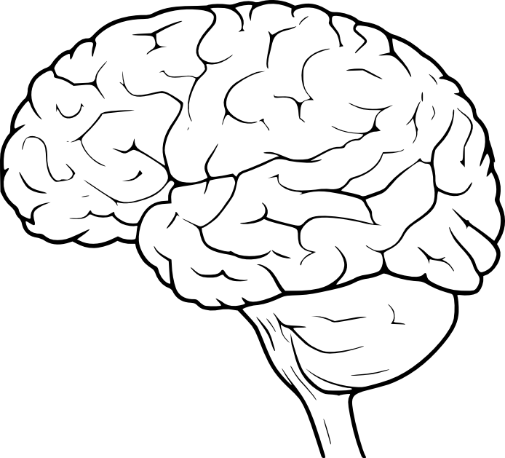


Triggering Emotions
Outrage
designed to provoke
and pull us in
keeps us
coming back
Curiosity
plays on our natural desire for closure and surprise
Notes:
Let me explain how. Emotions are powerful motivators—something we all know from experience—and YouTube understands this very well. The platform strategically taps into three key emotions to keep users engaged:
Outrage is sparked through controversial or divisive content, triggering strong reactions that lead to more clicks, comments, and shares. The algorithm amplifies this content because it fuels engagement. Think of sensational headlines like “This Politician’s Shocking Statement Will Anger You!”—designed to provoke and pull us in.
Curiosity is another powerful tool. Clickbait titles and eye-catching thumbnails are designed to make us interested. Phrases like “You Won’t Believe What Happened Next!” play on our natural desire for closure and surprise.
Joy keeps users coming back. Feel-good content, from heartwarming stories to hilarious bloopers, creates a positive feedback loop that encourages repeat visits. Videos like “Puppy Fails That Will Make You Laugh Out Loud!” flood our feed, making it easy to stay hooked.
By strategically triggering these emotions, YouTube ensures users spend more time on the platform—ultimately generating more data, more engagement, and, of course, more ad revenue.

Slide 22


Triggering Emotions
Outrage
designed to provoke
and pull us in
keeps us
coming back
Emotionally charged content performs better. A feedback loop is created where emotional manipulation isn’t just common – it’s the norm.
Curiosity
plays on our natural desire for closure and surprise
Notes:
YouTube profits by turning our emotional responses into data for advertisers. If you’ve been watching motivational videos, you’ll likely see ads for self-help books or fitness programs. If you’ve been engaging with political outrage content, expect ads for partisan merchandise or donation campaigns.
But it’s not just advertisers shaping what you see—content creators are incentivized to play into this system. Since emotionally charged content performs better, many creators lean into sensationalism, exaggerating stories or using clickbait tactics to maximize views. This creates a feedback loop where emotional manipulation isn’t just common—it’s the norm.

Slide 23




Rabbit Hole Effect
Pushes user to increasingly extreme content.
wellness-to-fascism pipeline
loneliness-to-facism pipeline
Notes:
So, triggering emotions is important in keeping us engaged. However, the problem with this strategy is, we humans adapt and may need increasingly more extreme content to *keep* us emotionally engaged. Enter the rabbit hole … effect.
For example, watching a single video about an “alternative” theory can lead to recommendations for even more radical versions of the same idea, feeding our curiosity or outrage. Even seemingly neutral, informational content like *health* can quickly funnel viewers into more polarizing material.
Research has highlighted conspiracy theory patterns like the wellness-to-fascism and loneliness-to-fascism pipelines, showing how the algorithm can nudge users toward increasingly extreme beliefs.

Slide 24
Rabbit Hole Effect
Pushes user to increasingly extreme content.
Maximizes engagement but also commodifies our emotional descent, as advertisers can target us based on their increasingly specific interests.
Notes:
Again, the goal of YouTube is *engagement*, and outrage is a powerful driver of that. Think of the last time you witnessed internet drama (maybe the Depp vs Heard trial). Conflict drives attention, drama drives engagement. Us being polarised is good for the YouTube algorithm. Being stuck in ideological bubbles and seeing "the other side" as increasingly alien or even dangerous is good for YouTube.
The result? We see the extremely oppositional *fragmentation* of public discourse. And that is good for YouTube as it maximises engagement.
This rabbit hole effect not only maximizes engagement but also commodifies our emotional (ans societal?) descent, as advertisers can target us based on our increasingly specific interests.

Slide 25


Hive Mind
Digital systems shape collective thought for profit.
Notes:
At the same time, YouTube pushes for predictability in human behavior. When we all think, behave and act similarly, advertising becomes a breeze.
Taking *communication* as an example, let’s explore how we become homogenised and standardised in the way we communicate *across* the internet:
Communication becomes more *binary* with political memes reducing complex issues to snarky captions (e.g., "This one image destroys X ideology!"). Communication across the internet becomes more *tribal* through mocking "the other side" (e.g., "Look how dumb they are!"), and reinforcing group identity. Communication across the internet becomes more *violent* through viral pile-ons, where algorithms feed us conflicts to exploit our drama-seeking impulses. We love drama.

Slide 26
Hive Mind
Digital systems shape collective thought for profit.
It becomes easier to be exploited by the algorithm and advertisers if
all users are the same.
Notes:
Advertisers can then push *identity-driven* purchases on us (e.g., eco-friendly products for "woke" hives, tactical gear for right-wing hives).
Even in our radicalization, our very human predictability allows YouTube to engineer *our* conformity. The result? A paradox: we’re divided into ideological bubbles, yet homogenized in our hive-like *behaviour*.
It's controlled chaos—where disagreement fuels the machine, but within and across different ideological bubbles, conformity is shaped.
The solution? Media literacy to recognize these patterns.

Slide 27

Potential Risks & Consequences
Radicaliation, polarisation, and division
Mental health impacts (e.g. peer pressure, risky behaviour)
Normalisation of extremisim and violence (e.g. toxic mob mentality)
Manipulation of behaviour (e.g. addiction and overuse)
Commercial exploitation of vulnerable users
Erosion of trust (e.g. spread of misinformation)
Notes:
Here is a list of potential risks and consequences, however, I will not go into this too much. Find me after the talk, if you want to chat.

Slide 28
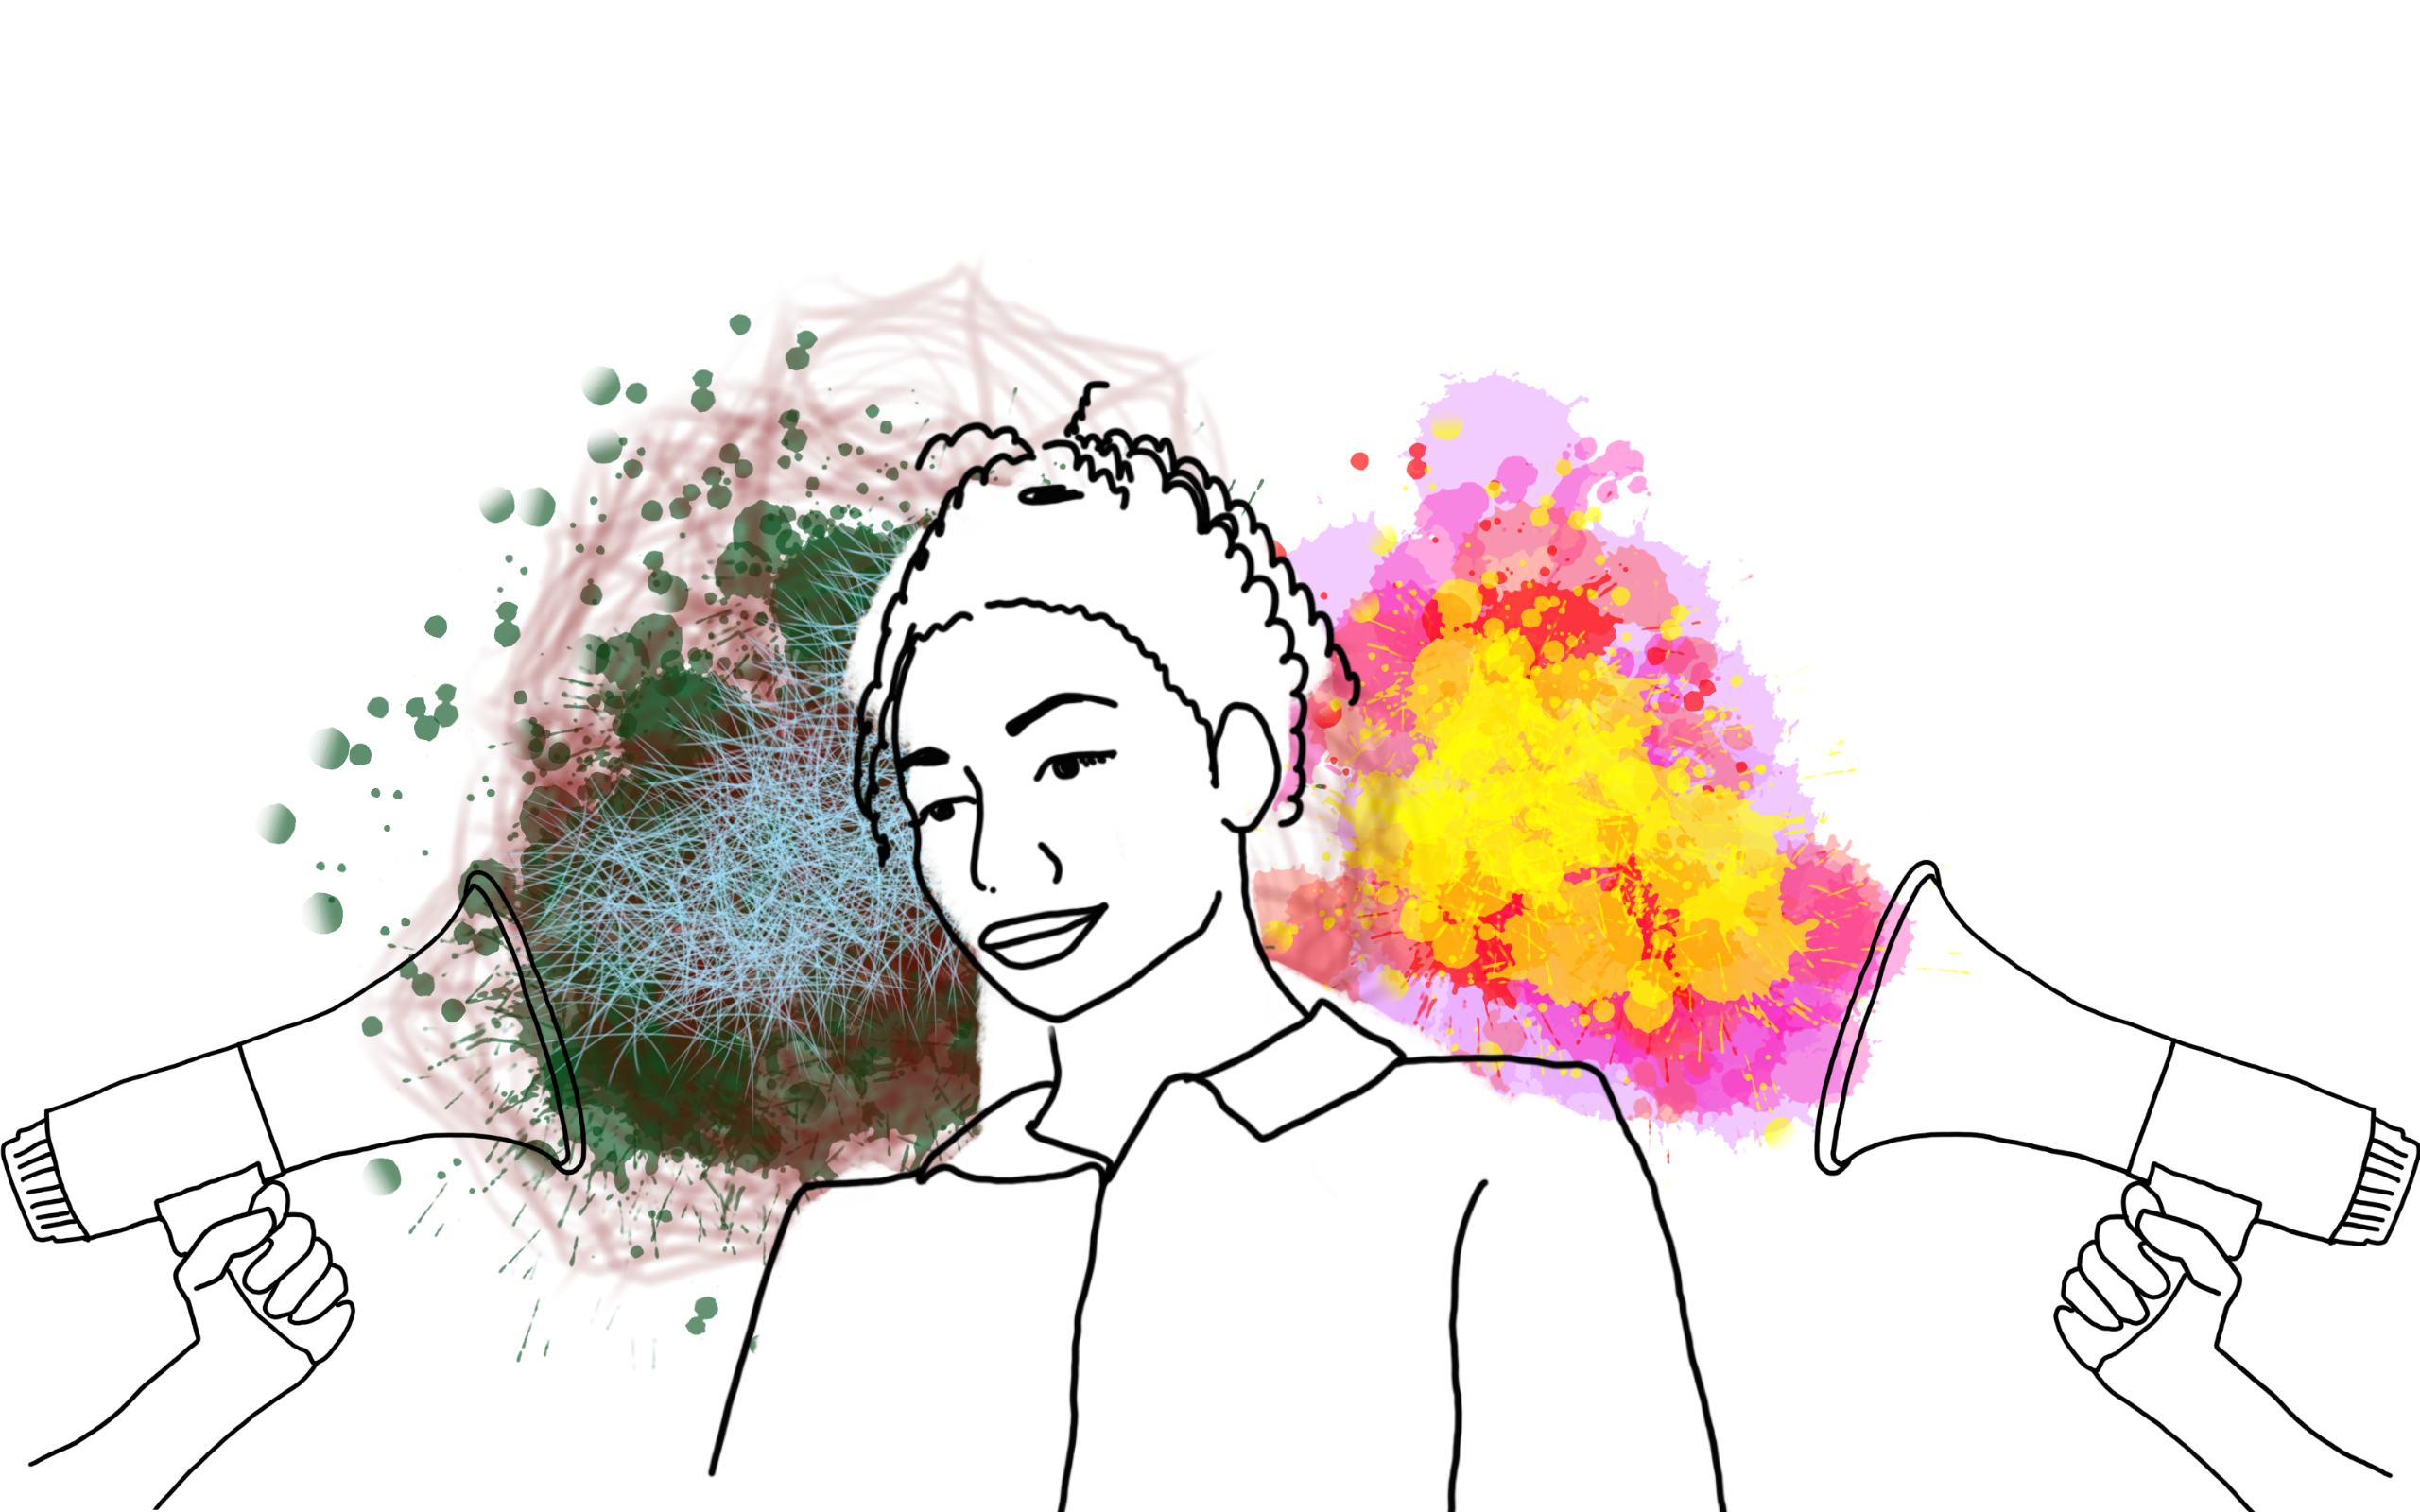
It’s complicated!
Notes:
This is a big, complex, and ever-evolving topic—and we’ve only scratched the surface. YouTube’s algorithm, its business model, and its role in behavioral modification are just the tip of the iceberg. There’s so much more to explore, like how other social media algorithms work. And trust me, it’s fascinating!
For example, did you know that research by Ibrahim et al. (2023) found YouTube’s algorithm has a left-leaning bias? If you drift into far-right content, the algorithm tries to pull you back. But if you lean far-left? It practically waves goodbye. Surprising, right?
This topic is equal parts terrifying, exciting, and dramatic—and I absolutely love its complexity.

Slide 29


The internet is
Access to Knowledge(s)
Global Connection
Empowerment and Autonomy
Entertainment and Joy
Notes:
Bernadette and I love love love the internet. Don’t misunderstand.
Access to Knowledge: the internet democratizes education.
Global Connection: It bridges cultural and geographical divides.
Empowerment: It gives a voice to marginalized communities, independent creators, and activists.
Entertainment and Joy: From music to comedy, the internet provides endless entertainment, lifting spirits and fostering creativity.

Slide 30
The internet is
Access to Knowledge(s)
Global Connection
Empowerment and Autonomy
Entertainment and Joy
More media literacy
to hold big tech accountable!
Notes:
But it is one of the least regulated industries. Every industry needs regulation otherwise capitalism goes awol and does despicable things—like the dehumanization of individuals.
How? By treating us as data points, ignoring and exploiting our mental health, extracting our personal data as a commodity, modifying our behavior without consent, and stripping away our privacy and autonomy.
This is exactly why media literacy is so crucial. It’s our best tool to fight dehumanization, hold Big Tech accountable, and reclaim our power. Because: knowledge is power.

Slide 31

Take Back Control!
Algorithmic Transparency
Media Literacy
Regulation
Ethical Design
Notes:
Equipped with media literacy and knowledge of how these algorithms work, we can level the playing field and use YouTube for *our intended purposes*: to watch videos on our favourite topics!
We *can* take back control of our behaviour, emotions, identities, and futures.
But we must fight for algorithmic transparency. We must fight for regulation. We must fight for ethical designs.
If you want to chat about how to tackle these individual solutions or collab with me in any way, just reach out to me after this presentation.
But if you need a more gentle path, and are not ready for full-blown revolution yet, I got you covered as well.

Slide 32
(3)
Strategies to become a
free thinker
and curate a healthier media diet
Notes:
What *you* can do to resist and reform our digital media landscapes.

Slide 33



Free Resources
Media Literacy Starter Kit incl.
5-step Guide towards more Media Literacy
Quick Guide to recognising AI generated content
Bonus: 5-day media detox / literacy challenge
Reading recommendations
Watching recommendations
Notes:
I will quickly glossing over the resources, giving you an overview of all the things I prepared for the NerdNite audience specifically. You can get all resources and tips and links and academic literature from this talk on my website. I will provide link and QR code at the end.

Slide 34





Applicable to all media
Notes:
And the tools and techniques I share with you today are applicable across all media, not only social media or YouTube.

Slide 35
Media Literacy Starter Kit
Resources to explore:
Data Detox Kit: https://datadetoxkit.org
Algorithmic Justice League: https://www.ajl.org/library/home
Crash Course Media Literacy: YouTube Series
National Association for Media Literacy Education: https://namle.org/
Personal favourites:
ad-blockers: e.g. uBlock origin, AdBlock Plus, adguard, Ghostery, etc
change your settings to make yourself less available to ad targeting (e.g. Facebook and Instagram) through tutorials on Data Detox Kit

Slide 36

5-step Guide towards more Media Literacy
Understand the source
Verify Information
Analyse the Message
Recognise Bias and Perspective
Engage Critically and Ethically

Slide 37
1. Understand the Source
Why it matters: Not all sources are created equal. Knowing who produced the content, their motivations, and their credibility is crucial.
How to do it:
Check the author’s credentials and expertise.
Investigate the publisher or platform (e.g., is it a reputable news outlet, a blog, or a social media account?).
Look for biases or potential conflicts of interest.
Tip: Use tools like Media Bias/Fact Check to evaluate the reliability of news sources. Be vigilant about people who provide “simple” explanations to complex issues.
Notes:
First of all, understand the source of your information. I describe why it matters, how to do it, and I provide tools and tips to getting you started.

Slide 38
2. Verify Information
Why it matters: Misinformation and disinformation are widespread. Verifying facts helps you avoid spreading false information.
How to do it:
Ask: Is it fact or opinion? Cross-check information with multiple reputable sources.
Use fact-checking websites like Snopes, FactCheck.org, PolitiFact or Wikipedia’s List of fact-checking websites.
Use fact-cheking browser extensions like NewsGuard or Media Bias/Fact Check.
Look for primary sources (e.g., official reports, studies i.e. Google Scholar, or direct quotes) whenever possible.
Tip: Be wary of sensational headlines or content that evokes strong emotions—these are often red flags for misinformation.
Notes:
Second, verify information.
In the spirit of Media Literacy, I challenge you to check out the resources I provide and make up your own mind about what the scientific literature says. Or find your own sources!

Slide 39
3. Analyse the Message
Why it matters: Media messages are often designed to persuade, entertain, or manipulate. Understanding the intent behind the content helps you interpret it critically.
How to do it:
Ask: Who is the target audience? What is the purpose of this message?
Identify persuasive techniques, such as emotional appeals, loaded language, or cherry-picked data.
Consider what is not being said—are there gaps or omissions in the information?
Tip: Learn about common logical fallacies (e.g., straw man, false dilemma) to spot flawed arguments.
Notes:
Analyse the message.

Slide 40
4. Recognise Bias and Perspective
Why it matters: All media content reflects some level of bias or perspective. Recognising this helps you interpret information more objectively.
How to do it:
Compare how different outlets cover the same story.
Be aware of your own biases and how they might influence your interpretation.
Look for diverse perspectives, especially on controversial topics.
Tip: Use tools such as AllSides to shows bias ratings for news outlets or stories or help you understand persuasive techniques used in specific ads to influence buyers. Follow a range of news sources with different political leanings to get a balanced view.
Notes:
Fourth, recognise bias and perspective.
Recognize that every piece of media has bias – yes, even this talk. Consider the perspective of the creators and how it might influence the message. Be aware of political, cultural, and economic factors that can shape news reporting, advertising, or content creation.

Slide 41
5. Engage Critically and Ethically
Why it matters: Media literacy isn’t just about consuming information—it’s also about how you engage with and share it.
How to do it:
Pause before sharing content online. Ask: Is this accurate? Is it helpful? Could it harm others?
Engage in respectful discussions, even when you disagree.
Educate others about media literacy and the importance of critical thinking.
Tip: Use tools like AI Content Detector or Reverse Image Search to verify the authenticity of photos and texts before sharing.
Notes:
Finally, engage critically and ethically.

Slide 42
Quick Guide to Recognising AI generated content
Images: unnatural details, inconsistent textures and lighting, repetitive patterns, metadata inspection, Reverse Image Search
AI detection tools and plugins: e.g. InVID, FakeImageDetector, ...
Videos: visual inconsistencies (e.g. flickering, weird transitions), audio mismatch, metadata inspection
deepfake detection tools and plugins: e.g. DeepWare, SensityAI, …
Text: repetitive or unnatural phrasing, overly generic or vague information, lack of personal experiences or emotions
AI detection tools and plugins: e.g. Hugging Face Detector, Originality.ai, GPTZero, CopyLeaks, ...
Social media posts: too perfect or generic posts, hashtags or keywords
Notes:
I also createde a quick guide to recognising AI generated content for you: images, videos, text, and social media posts.

Slide 43
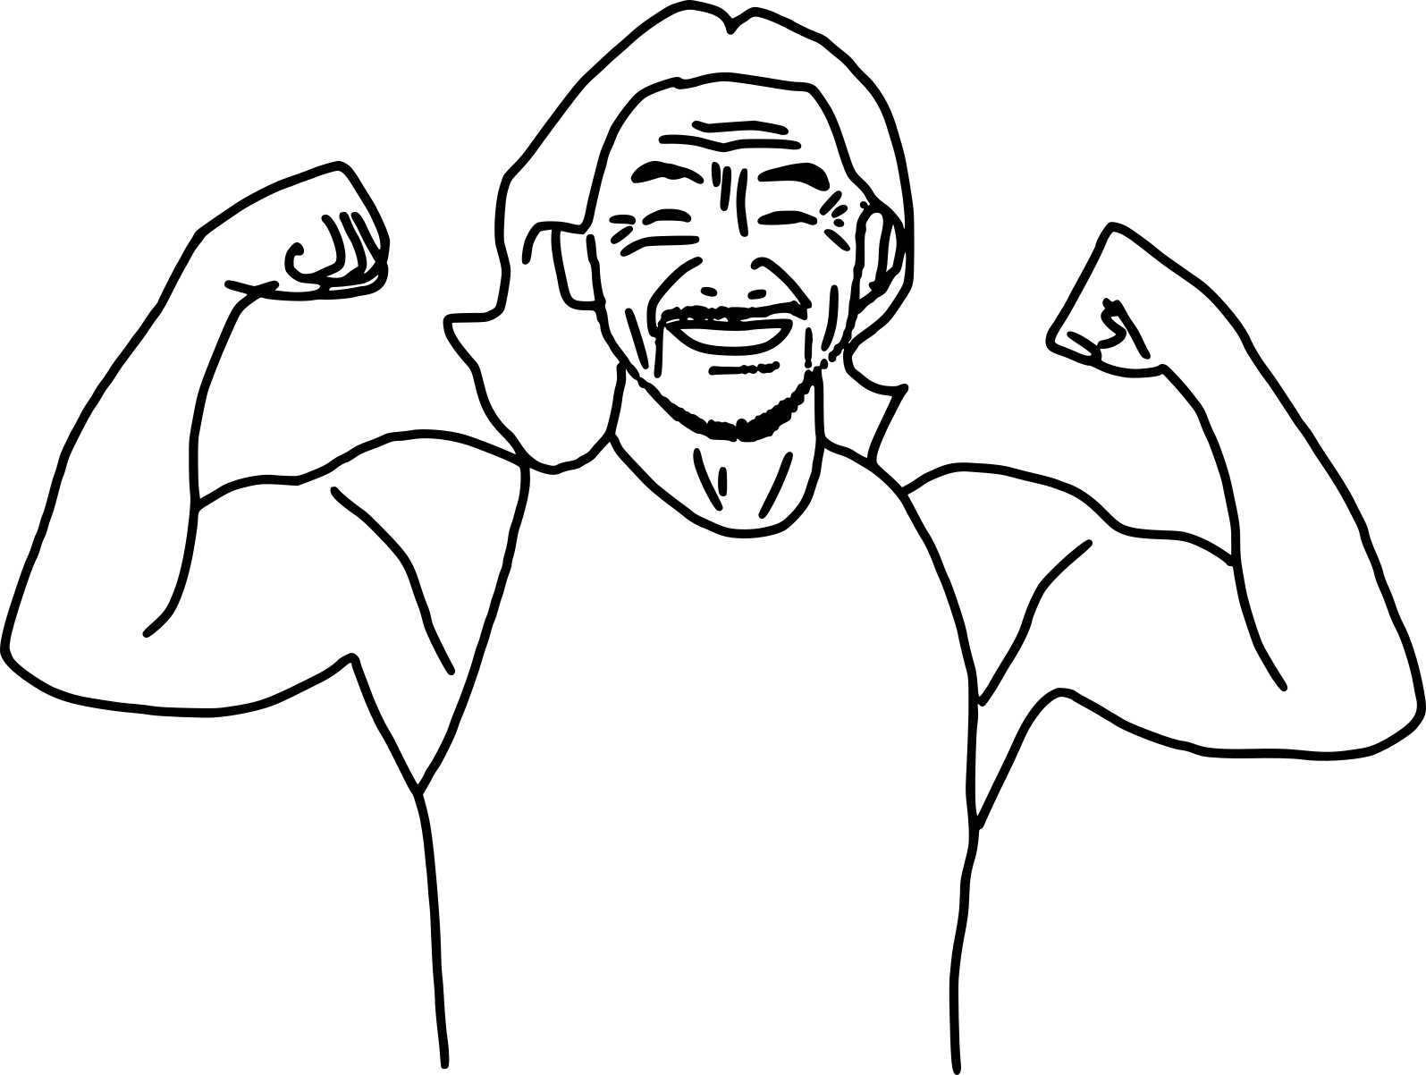
5-day Media Literacy Challenge
Day 1: Reclaim Your Focus
Day 2: Explore New Perspectives
Day 3: Go Beyond the Headlines
Day 4: Cut the Noise
Day 5: Build a Wholesome Feed
*based on the 5-day challenges from University of Maine and Dasia Sade.
Notes:
I also created a 5-day media literacy challenge just for you.
I clearly defined the goal for each day, with clearly defined steps.

Slide 44

Day 1: Reclaim Your Focus
Goal: Break free from mindless scrolling and reconnect with yourself and your surroundings.
Set 3 specific times to check news (e.g., 9am, 12pm, 6pm).
Reflect: How did you feel, think, and act today?
Replace one screen habit with a non-screen activity.

Slide 45

Day 2: Explore New Perspectives
Goal: Get comfortable with diverse viewpoints and approach media with curiosity.
Read a news source from a different cultural or political background.
Reflect: What surprised, challenged, or intrigued you?
Fact-check one story from this source.
Share your insights with someone.

Slide 46

Day 3: Go Beyond the Headlines
Goal: Dive deeper into stories and recognize different angles of truth.
Compare one story across 3 outlets with differing viewpoints.
Reflect: What stood out, was missing, or felt biased?
Question assumptions, tones, and nuances.
Discuss your media journey with someone.

Slide 47
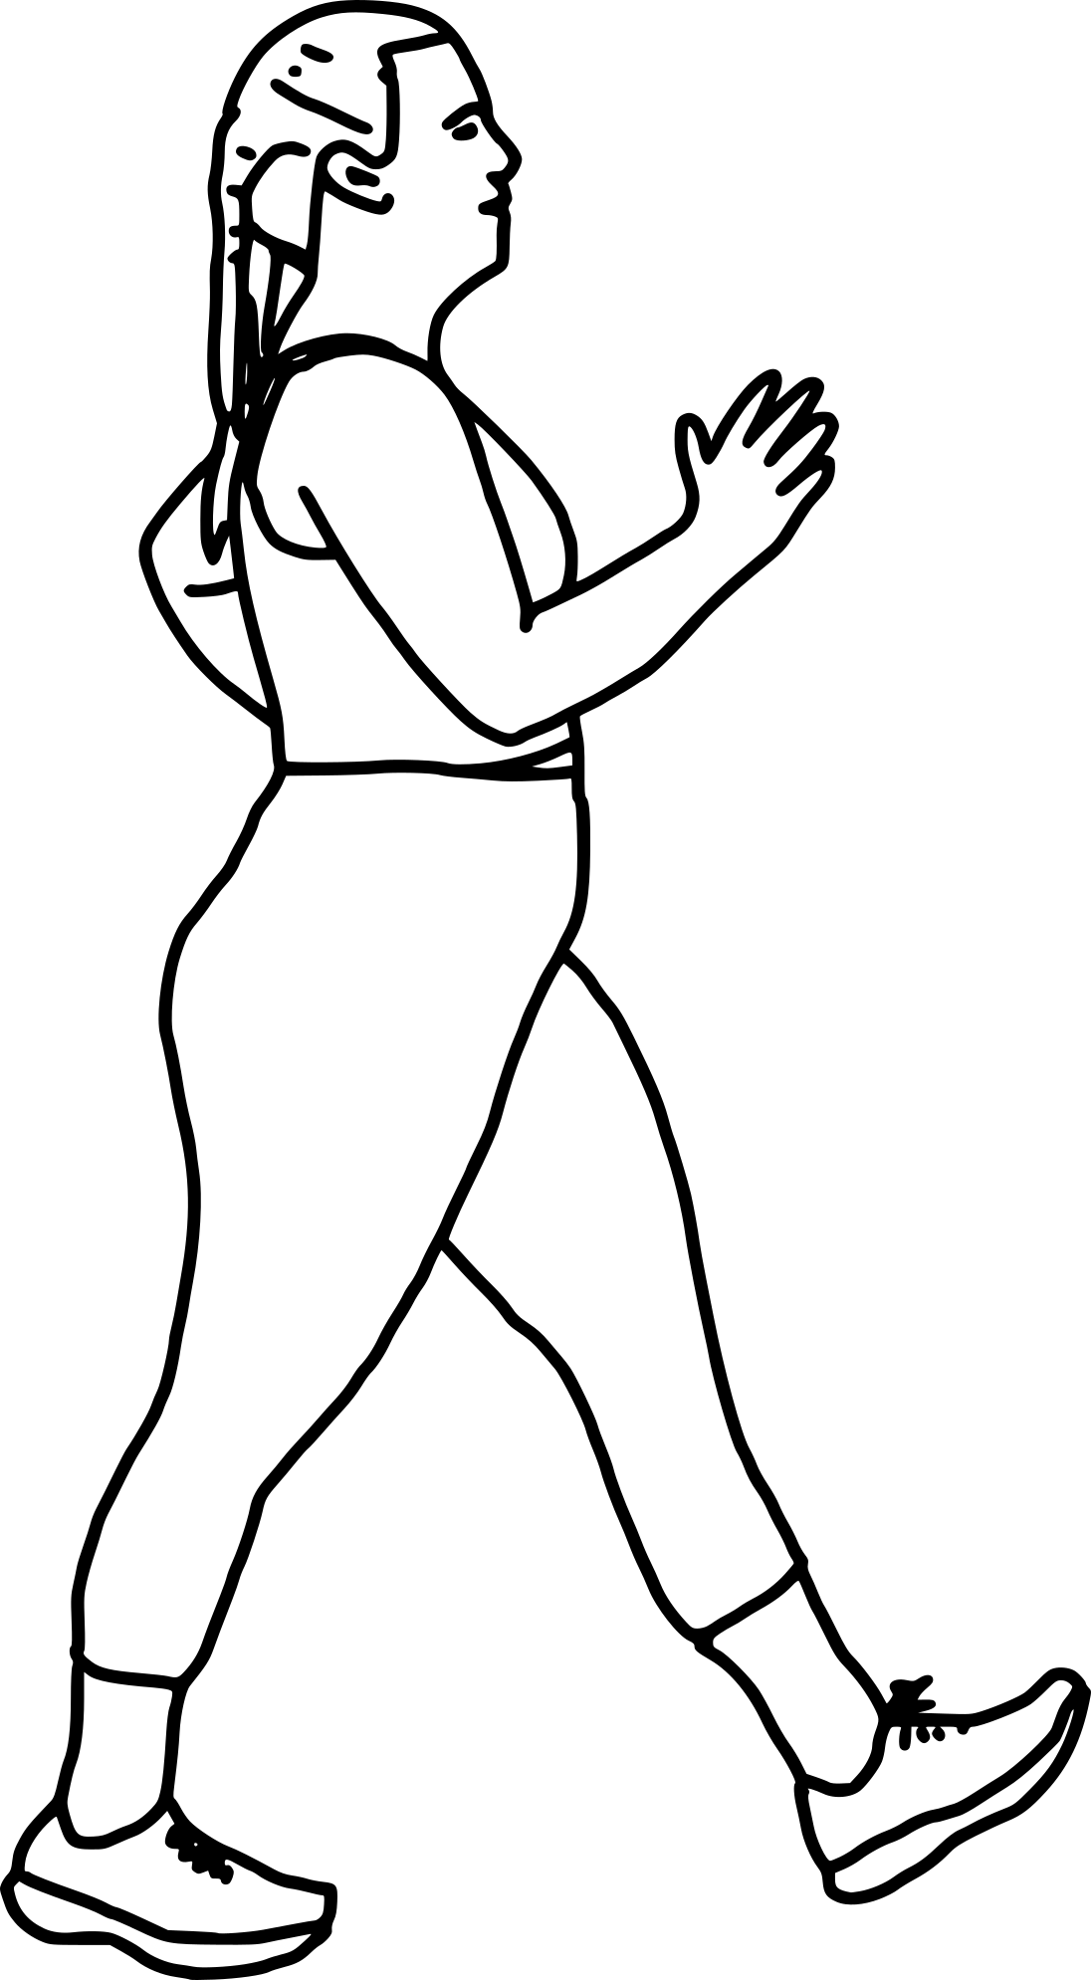
Day 4: Cut the Noise
Goal: Curate a media feed that informs rather than drains or manipulates.
Identify a story that prioritizes drama over value.
Reflect: Did it trigger emotions? Was that intentional? What was its purpose?
Unfollow three sources that provoke more than they inform.

Slide 48

Day 5: Build a Wholesome Feed
Goal: Fill your feed with content that educates, inspires, and connects.
Discover 3 news sources known for depth and fairness.
Reflect: How do they make you feel? Are you genuinely informed?
Discuss your media journey with someone.
Notes:
I hope this challenge will be useful to you.

Slide 49
Recommended Reading
Zuboff, Shoshana (2019):
The Age of Surveillance Capitalism: The Fight for a Human Future at the New Frontier of Power
Benjamin, Ruha (2019):
Race After Technology: Abolitionist Tools for the New Jim Code
D'Ignazio, Catherine; Klein, Lauren (2020)
Data Feminism
Monea, Alexander (2022):
The Digital Closet: How the Internet Became Straight
Notes:
Finally, …

Slide 50
Recommended Watching
Can’t feel nothing (2024) by David Borenstein; on Arte
Coded Bias (2020) by Shalini Kantayya; on Algorithmic Justice Leage
The Great Hack (2019) by Jehane Noujaim, Karim Amer; on Netflix
The Social Dilemma (2020) by Jeff Orlowski; on Netflix

Slide 51
To summarise ...
Notes:
No more smiling !

Slide 52
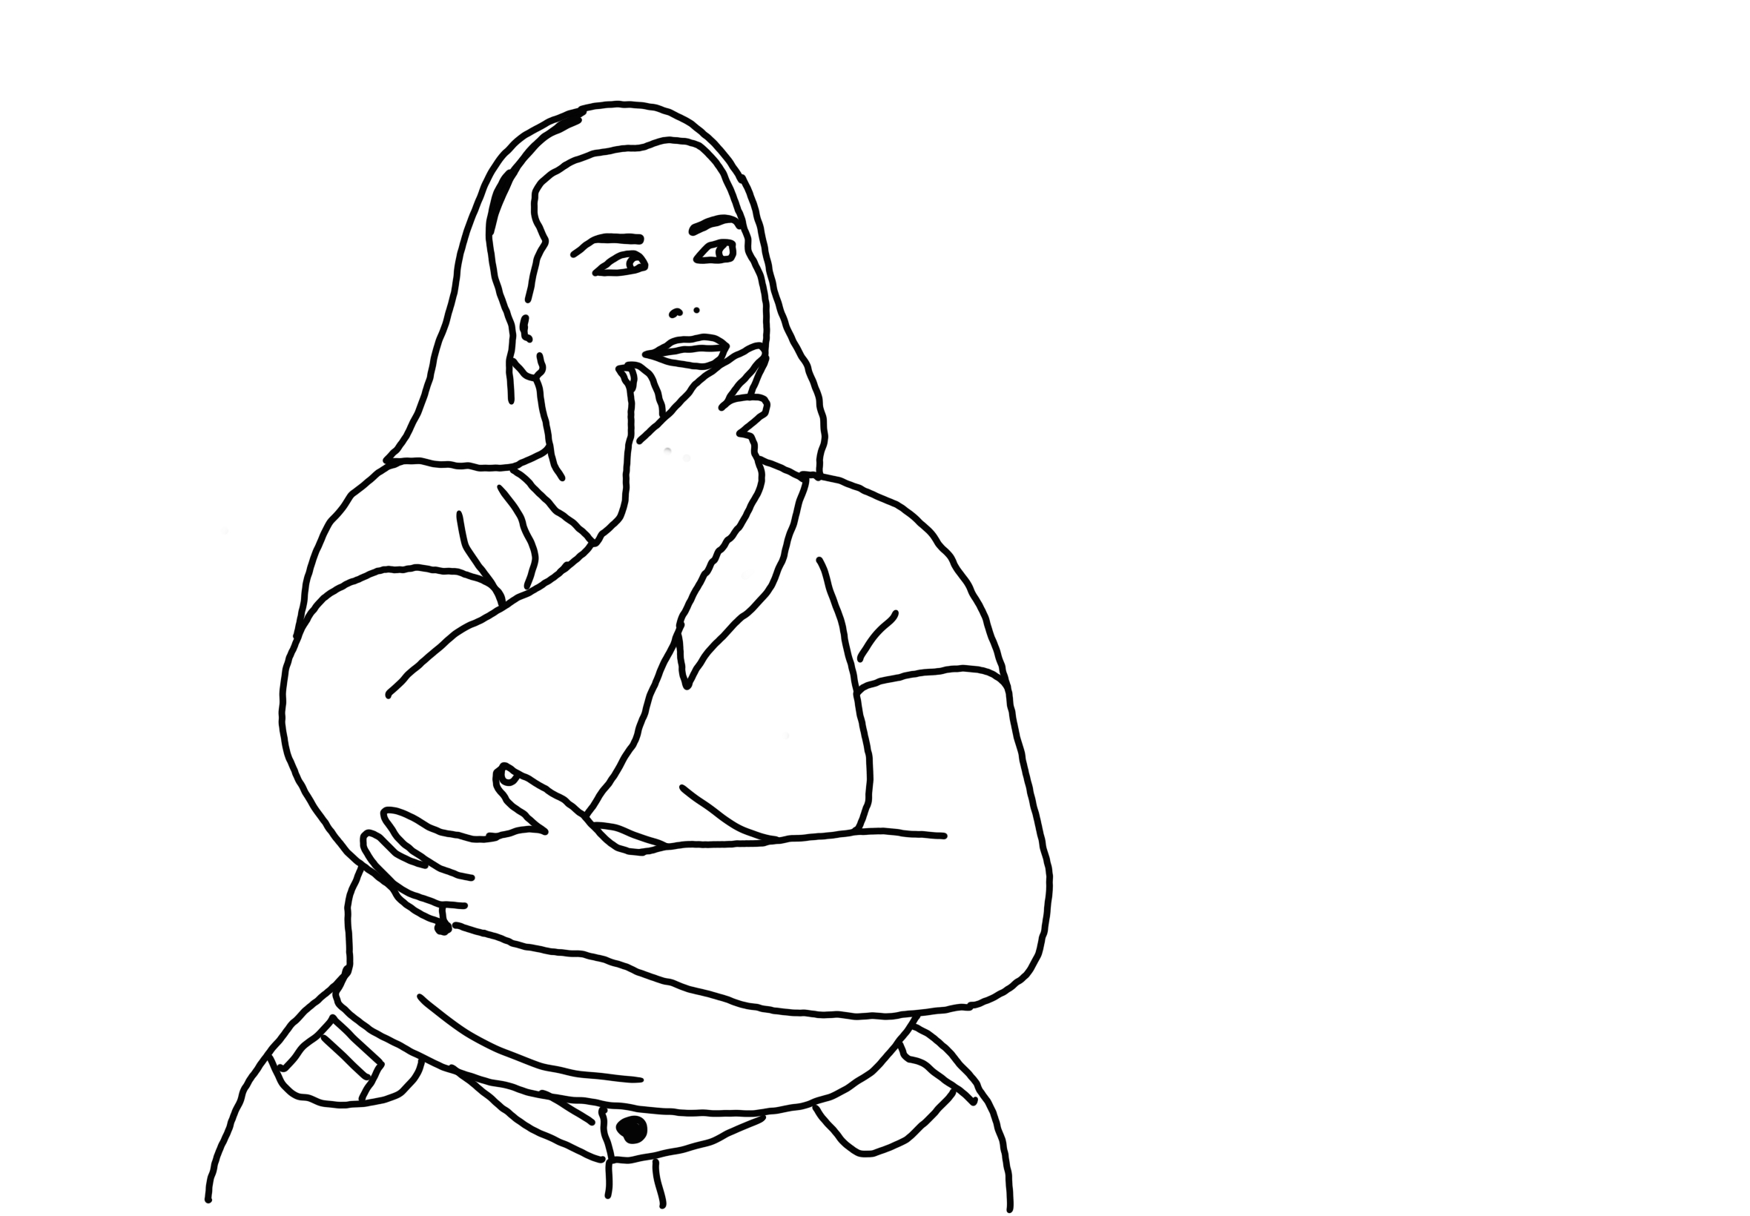
I hope you understand why ...
you have found yourself a little bit angrier, more confused, and more lost than usual as of late?
you “lost” friends and family members to fake news?
you have lost your uniqueness?
Notes:
Going back to the beginning when I asked you questions about the last time you found yourself emotionally activated, or whether you have lost friends; or whether you have lost your uniqueness?
My only wish for today is that you now understand better, what is happening behind the scenes – within the algorithms and the digital business models.

Slide 53

We got this!
Stay aware!
Make informed decisions.
Spread the word about media literacy.
Remember: each little action is important. Only together can we change the world.
Keep up the joy, keep up the fight!
Notes:
But most importantly: we got this. Do not despair!
Stay aware of how platforms like YouTube commodify our experiences. Be vigilant of people who sell you a simple “truth” to a complex problem. Try to embrace the discomfort of uncertainty.
Make informed decisions about what you watch, share and engage with.
Spread the word about media literacy, it’s vital!
And remember: Keep up the joy and keep up the fight. Do not give in to nihilistic fatalism. If you do nothing to actively work on avoiding a horrible future, you give in to that futre. We have the power. Each one of us counts.

Slide 54
Notes:
Keep up your fight and most importantly, keep your joy. Spread joy wherever you can. In these times, we need joy!

Slide 55





Thank you! Questions?
www.shakeri.eu
gozel@shakeri.eu
Resources
Notes:
I want to thank you for your attention and … Any questions?
DURING QUESTIONS:
Advertise this talk – I am happy to give it whenever and whereever.

Slide 56
References
Books:
Zuboff, Shoshana (2019). The Age of Surveillance Capitalism: The Fight for a Human Future at the New Frontier of Power. New York: PublicAffairs.
Srnicek, N. (2017). The Challenges of Platform Capitalism: Understanding the Logic of a New Business Model. Juncture, 23, 254-257. https://doi.org/10.1111/newe.12023
Van Dijck, José Francisca Theodora Maria, Thomas Poell, and Martijn De Waal. The Platform Society: Public Values In a Connective World. New York (N.Y.): Oxford university press, 2018.
Algorithms:
Baker, S. A. (2022). Alt. Health Influencers: how wellness culture and web culture have been weaponised to promote conspiracy theories and far-right extremism during the COVID-19 pandemic. European Journal of Cultural Studies, 25(1), 3-24. https://doi.org/10.1177/13675494211062623
Spreeuwenberg, L. (2022). The moral implications of cancel culture. Ethical Perspectives, 29(1), 89–114.
Pfundmair, M., Wood, N.R., Hales, A. & Wesselmann, E.D. (2024) How social exclusion makes radicalism flourish: A review of empirical evidence. Journal of Social Issues, 80, 341–359. https://doi.org/10.1111/josi.12520
Norris, P. (2021). Cancel Culture: Myth or Reality? Political Studies, 71(1), 145-174. https://doi.org/10.1177/00323217211037023
Hesmondhalgh, David and Campos Valverde, Raquel and Kaye, D. Bondy Valdovinos and Li, Zhongwei, The Impact of Algorithmically Driven Recommendation Systems on Music Consumption and Production: A Literature Review (February 9, 2023). UK Centre for Data Ethics and Innovation Reports, Available at SSRN: https://ssrn.com/abstract=4365916
Tong, Z., Liu, H., Feng, J., Wang, W., Wu, H. and Xu, J. (2025), Trapped by AI Recommendation: How Identity Concerns Reduce Variety-Seeking Behavior. Manage Decis Econ. https://doi.org/10.1002/mde.4524
Specifically on YouTube’s Algorithm:
Lewis, R., & Christin, A. (2022). Platform drama: “Cancel culture,” celebrity, and the struggle for accountability on YouTube. New Media & Society, 24(7), 1632-1656. https://doi.org/10.1177/14614448221099235
Jack Nicas, 2018. How YouTube Drives People to the Internet’s Darkest Corners, Google’s video site often recommends divisive or misleading material, despite recent changes designed to fix the problem. The Wall Street Journal. Here
Munger, Kevin, and Joseph Phillips. "Right-wing YouTube: A supply and demand perspective." The International Journal of Press/Politics 27, no. 1 (2022): 186-219. https://doi.org/10.1177/1940161220964767
Hana Kiros, 2022. Hated that video? YouTube’s algorithm might push you another just like it. MIT Technology Review. Here
Rieder, B., Matamoros-Fernández, A., & Coromina, Ò. (2018). From ranking algorithms to ‘ranking cultures’: Investigating the modulation of visibility in YouTube search results. Convergence, 24(1), 50-68. https://doi.org/10.1177/1354856517736982
Birchall, C., Knight, P., & Knight, S. (2024). Conspiracy Loops: From Distrust to Conspiracy to Culture Wars. Demos. https://demos.co.uk/wp-content/uploads/2024/04/Conspiracy-Loops_Report.pdf
Hazem Ibrahim, Nouar AlDahoul, Sangjin Lee, Talal Rahwan, Yasir Zaki, YouTube’s recommendation algorithm is left-leaning in the United States, PNAS Nexus, Volume 2, Issue 8, August 2023, pgad264, https://doi.org/10.1093/pnasnexus/pgad264
Yesilada M, Lewandowsky S. Systematic review: YouTube recommendations and problematic content. Internet Policy Rev. 2022 Mar 31;11(1):1652. doi: 10.14763/2022.1.1652. PMID: 36466439; PMCID: PMC7613872.
Zuboff, S. (2015). Big other: Surveillance Capitalism and the Prospects of an Information Civilization. Journal of Information Technology, 30(1), 75-89. https://doi.org/10.1057/jit.2015.5
Couldry, N., & Mejias, U. A. (2019). Data Colonialism: Rethinking Big Data’s Relation to the Contemporary Subject. Television & New Media, 20(4), 336-349. https://doi.org/10.1177/1527476418796632
West, S. M. (2019). Data Capitalism: Redefining the Logics of Surveillance and Privacy. Business & Society, 58(1), 20-41. https://doi.org/10.1177/0007650317718185
Google occasionally publishes white papers and blog posts about YouTube’s algorithm and business practices. These can be found on the Google AI Blog, YouTube’s Creator Academy, and Google Research Blog.
Icons by Larea from Noun Project (CC BY 3.0)

Slide 57
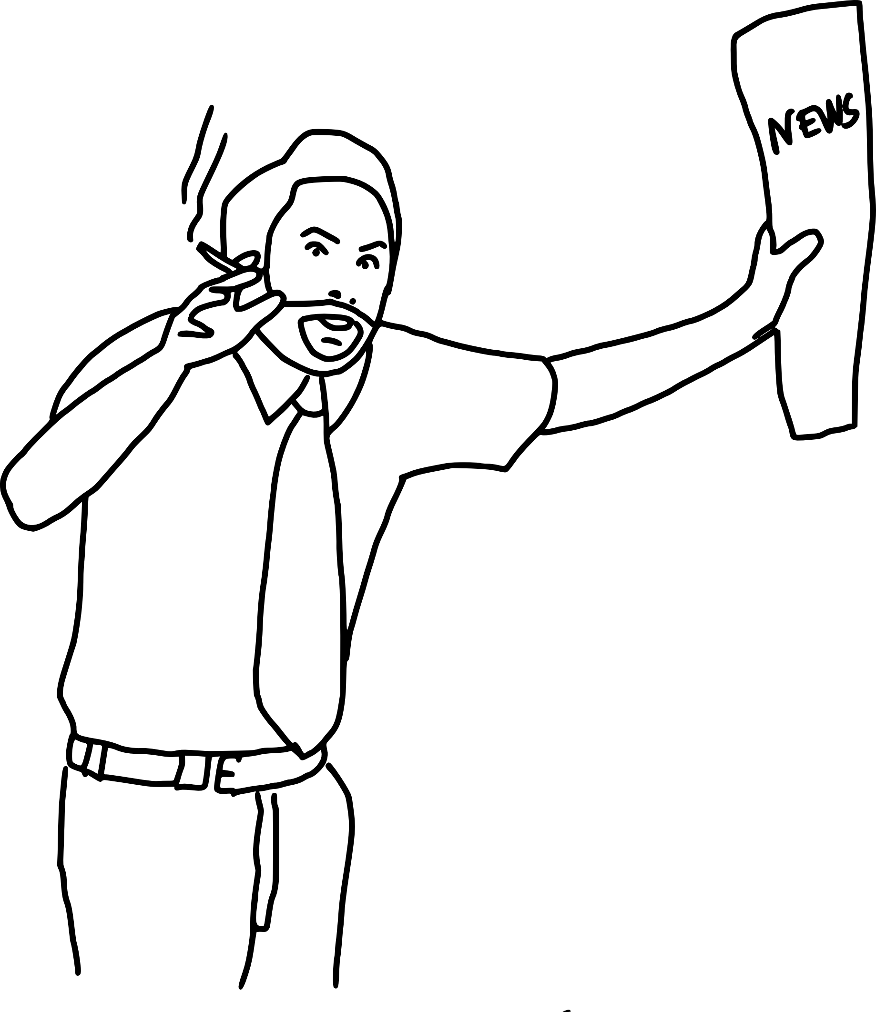
It’s all connected!
Eco-systems (e.g. Google)
Social Media Academies and Consultancies
Data Analytics and Behavioral Insights Firms (i.e. Affective Computing)
Fake News and Propaganda Organisations
Notes:
There is a huge industry behind our emotional manipulation.
A growing industry of companies and technologies actively trains content creators and leverages affective computing to maximize emotional manipulation online. Social media academies, influencer platforms, and content creation tools teach creators how to use emotional triggers—like fear, joy, or outrage—to boost engagement. Meanwhile, affective computing firms use AI to analyze emotions through facial expressions, voice, and text, enabling hyper-targeted advertising and personalized content. These technologies are often deployed by advertising agencies, data analytics firms, and social media platforms themselves, which prioritize emotionally charged content to drive clicks, shares, and revenue.

Slide 58

Be vigilant!
Collective anxiety creates a vacuum for figures who have “figured it out”
Figures speaking with authority – speaking "truth" - exploit our need for certainty
e.g. explainer journalists like Ezra Klein
Notes:
In times of uncertainty and instability, it’s natural to seek guidance and clarity. Today, many of us feel lost—caught in a whirlwind of rapid technological change, economic instability, political polarization, and existential threats like climate change. This collective anxiety creates a vacuum, a longing for someone or something to provide answers, direction, and a sense of purpose. Historically, religion filled this role, offering a framework for understanding the world and our place in it. But as traditional religious structures lose their grip on modern society, new figures have emerged, claiming to have figured out life and offering their own versions of "truth" with unwavering authority.
These figures—whether they are self-proclaimed gurus, charismatic leaders, or influencers—exude confidence and power, promising clarity in a chaotic world. They tap into our deepest fears and desires, offering simple solutions to complex problems. And in our vulnerability, they become increasingly attractive. But here’s the catch: their authority is often a facade, their "truth" a carefully crafted narrative designed to exploit our need for certainty. What they’re really selling is not wisdom, but control—over our thoughts, our choices, and ultimately, our lives.
This is why, especially now, we must be vigilant. When we feel lost, it’s easy to fall into the trap of blindly following those who speak with authority. But true clarity doesn’t come from surrendering our critical thinking to others; it comes from questioning, reflecting, and seeking understanding on our own terms. We must resist the allure of cultish figures who promise easy answers and instead embrace the discomfort of uncertainty. It’s in this space of questioning and exploration that we find not only resilience but also the freedom to define our own paths.
So, as we navigate this era of collective anxiety, let’s remain vigilant. Let’s think critically, challenge authority, and remember that no one has all the answers—not even those who claim to. The real power lies not in blindly following, but in daring to question, to learn, and to grow.

Slide 59

Are you not entertained?!?
Hot take #1:
Content creators are our modern gladiators
We love bloodshed and drama?
They are the most media literate people out there
Notes:
Content creators are the most media literate people out there. They understand digital systems like nobody else. If you want to become a successful content creator, get media literate. Let your exploitation be informed!

Slide 60

Cancel Culture
Hot take #2:
Historical Context of Canceling
Cancel Culture vs. True Accountability
Psychological dangers of public shaming
When Canceling Works (and Fails)
Path Forward
Broder, J.L. (2024). Complex Dynamics of Cancel Culture in the Media. In: Rich, G.J., Kumar, V.K., Farley, F.H. (eds) Handbook of Media Psychology. Springer, Cham. https://doi.org/10.1007/978-3-031-56537-3_17
Jahanbin, N. The Significance in Diminishing Shame Culture: An Analysis on Cancel Culture. In: The NCHC Journal of Undergraduate Research & Creative Activity. https://nchcureca.com/the-significance-in-diminishing-shame-culture-an-analysis-on-cancel-culture/
Notes:
1. Canceling mirrors ancient practices of social ostracism used to enforce norms, but modern cancel culture operates at unprecedented speed/scale due to social media, often acting as a first response rather than a last resort.
2. Accountability encourages growth; cancel culture focuses on punishment. Studies (e.g., the Academia.edu paper) show it conflates public shaming with justice, offering no path to redemption.
3. Public shaming triggers aggression or withdrawal (per the SPSSI study), correlates with mental health crises, and lacks proportional consequences for online mobs—making it a destructive tool.
4. Cancel culture succeeds only when targeting systemic power (e.g., #MeToo) with clear, restorative approaches. Currently, it’s asymmetrically weaponized, disproportionately harming marginalized groups.
5. Replace shame with restorative approaches: prioritize dialogue, reject isolation tactics, and design systems that balance consequences with opportunities for change.

Slide 61
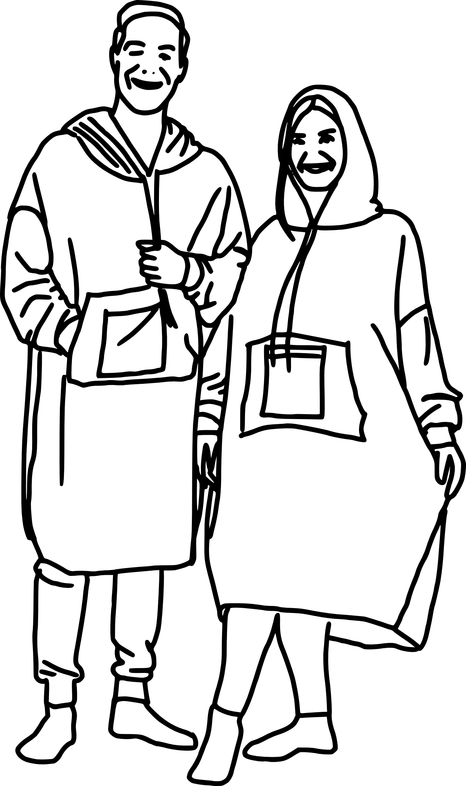
Hoodie Blanket
Notes:
Do you recognize this? It’s a hoodie blanket—a trend that took off this winter.
I know because, suddenly, everyone I knew had one. Whether I was video-chatting with friends in London, Germany, or France, they were all wrapped up in these cozy, comfy things. And honestly, I’m not judging—it looks warm, snug, and downright luxurious!
But what really struck me was the international scale of this trend. How did people across the Europe all decide to buy the same thing at the same time? It’s not a piece of clothing we saw people wear on the streets. This is a very intimate piece of fashion, we only wear in the comfort of our homes. We can have only seen it on the social media apps, nowhere else. And yet, it became a global trend.
And if this kind of global behavioral modification can influence something as simple as “chilling in the house” fashion, imagine what it’s doing to our political landscapes.
But that’s a rabbit hole I’ll leave for you to explore.

Slide 62
“The Great Flattening of Cultures”
Digital platforms reinforce normative ideals.
Non-conforming ideas, identities, and expressions are marginalized.
Notes:
And this is all very very human behaviour. We are social beings, we want to belong to a group, we thrive on drama, we love feeling morally superior to others, and we want to influence. Very human. I am not judging.
But all of this is happening on a global scale.
Something is happening to culture, and it’s not just in your head. You’ve probably noticed it too—a creeping *sameness* in music, art, fashion, and even personal identity. I call this "The Great Flattening of Culture," a phenomenon where human diversity is being eroded, not by accident, but by algorithm.
By feeding us most predictable and commercially viable content, algorithms shape what we are exposed to, ergo what we eventually come to think and like. And a hive is easier to market to. ;-)
The result? A self-reinforcing cycle where we are continuously fed what is most popular, and in turn, we become part of that mainstream, reducing us to predictable, monetizable data points.

Slide 63
“The Great Flattening of Cultures”
Digital platforms reinforce normative ideals by promoting content that aligns with mainstream.
Feedback loop where non-conforming ideas, identities, and expressions are marginalized.
Richness of human experience is overshadowed by homogenized, algorithmically-driven content.
Notes:
This isn’t just about music or art—it’s about identity itself. Consider how music today blends genres—not in an innovative way, but in a way that smooths out their rough edges, making them more palatable to the masses. Niche and genre-specific artists are pushed to the margins, their distinctiveness erased in favor of broadly appealing, algorithm-friendly sounds. This same logic applies to human expression: anything outside the mainstream, particularly marginalized identities like LGBTQ+ voices, is systematically pushed to the fringes, because it’s commercially less profitable. Researchers found, the internet is more heteronormative than ever! We are all slowly going back into the digital closet.
Even worse, algorithms don’t just amplify what’s popular; they thrive on outrage and polarization, often reinforcing conservative values because they are the most emotionally charged. This creates a digital landscape where complexity is stripped away, reducing human experience to binary oppositions, and further manifesting cultural homogenization.
The consequences are profound. Culture should be a reflection of our full, messy, vibrant human experience—but instead, it’s being reduced to what is safest, most profitable, and easiest to market. If we don’t push back, we risk losing the richness of our identities, our creativity, and our capacity for true expression.
The question is: Are we willing to let algorithms define us, or will we fight to reclaim our diversity?

Slide 64

We are the product
for sale
Notes:
It should be very evident, that our human experiences are manipulated and commodified. Our basic data, our behaviours, our emotions, and our futures are sold for profit.
We are the product.

